Slide 1

Data Exploration and Analysis-
Presentation tools
DSA0504- QUERY PROCESSING FOR DATA SCIENCE
PRESENTED BY:
JEYA HARSHINI R (192424051)
GUIDED BY:
DR MAHESH MUTHULAKSHMI

Slide 2
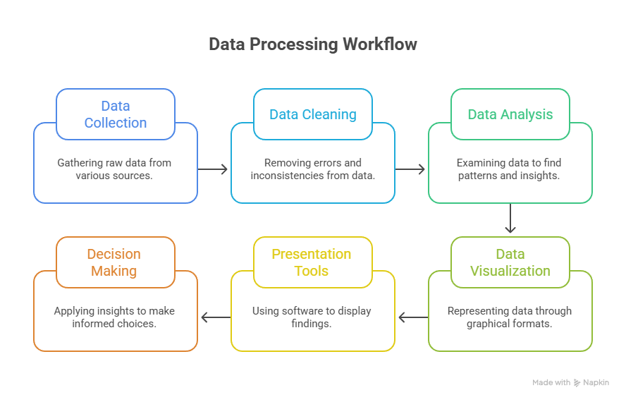
Where Presentation Tools Fit in Data Exploration

Slide 3
What are Presentation Tools?
Definition
Presentation tools are software applications that convert analytical results into meaningful visual reports, dashboards, charts, and presentations for effective decision-making.
Key Functions
Present analytical findings
Create charts & dashboards
Interactive reports
Business storytelling
Share insights with stakeholders

Slide 4
Advantages of Presentation Tools
✅ Improved Data Visualization
Converts complex data into easy-to-understand charts, graphs, and dashboards.
✅ Better Decision Making
Helps managers and stakeholders identify trends and make informed decisions quickly.
✅ Interactive Analysis
Allows users to filter, drill down, and explore data dynamically (e.g., Power BI).
✅ Enhanced Communication
Makes it easier to present analytical findings to technical and non-technical audiences.
✅ Time-Saving and Efficient
Automates report generation and simplifies the presentation of large datasets.

Slide 5
Types of Presentation Tools
Tool | Purpose
Microsoft Excel | Charts, Pivot Tables, Reports
Microsoft PowerPoint | Present insights
Jupyter Notebook | Code + Graphs + Documentation
Power BI | Interactive Dashboards
Tableau | Business Visualization
Google Looker Studio | Cloud Dashboards

Slide 6
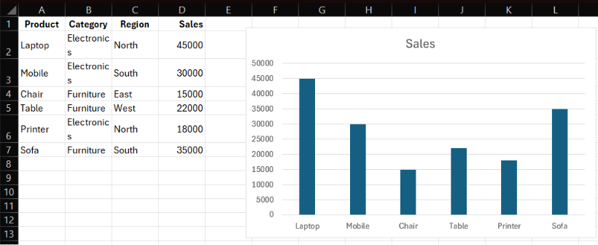
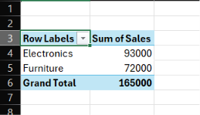
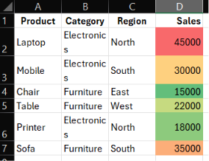
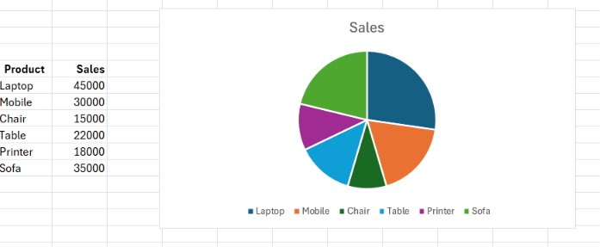

Slide 7
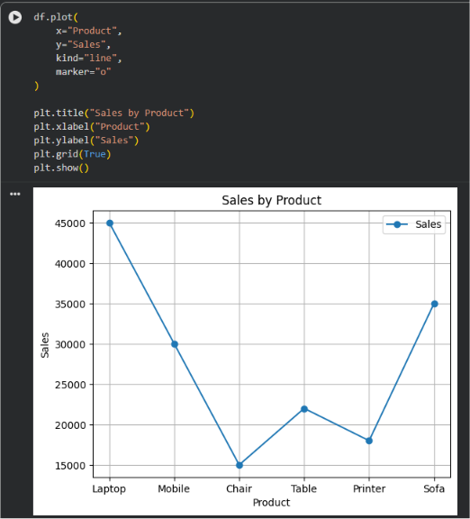
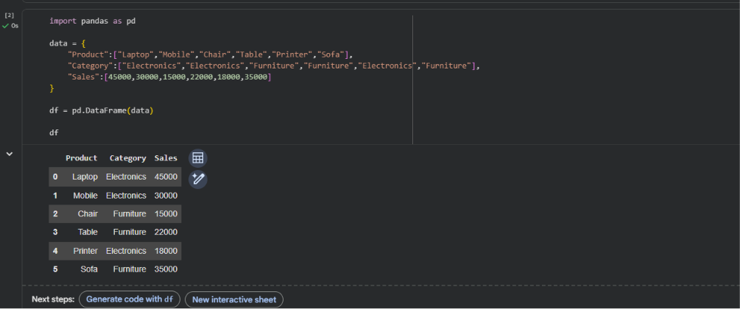
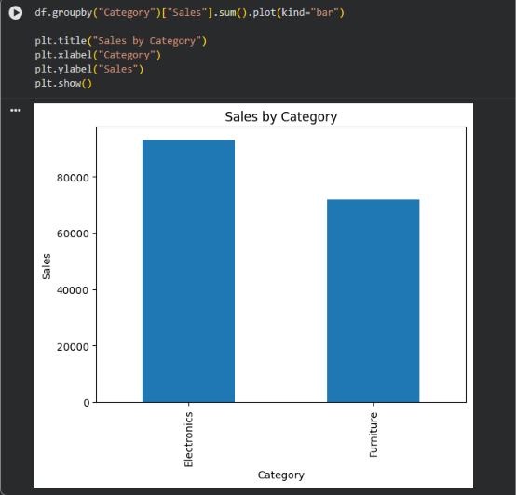
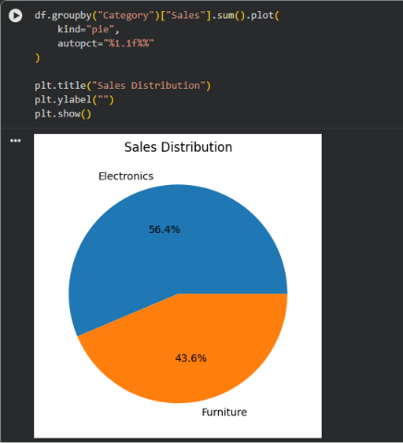
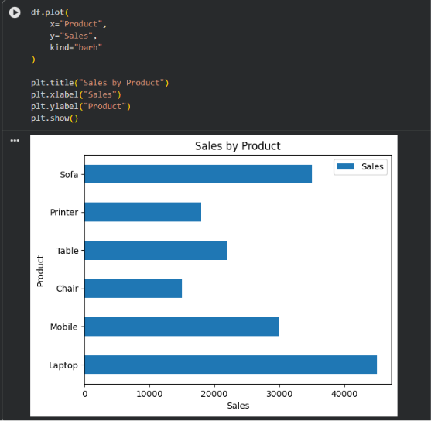
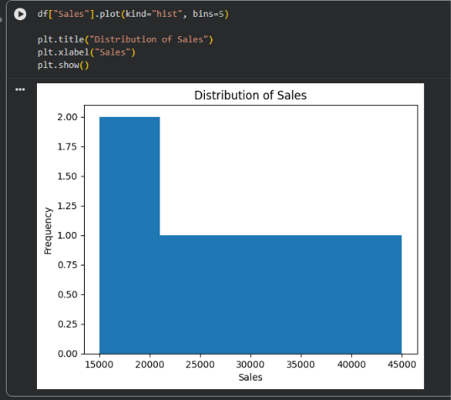

Slide 8
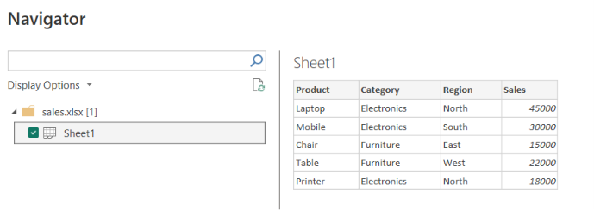
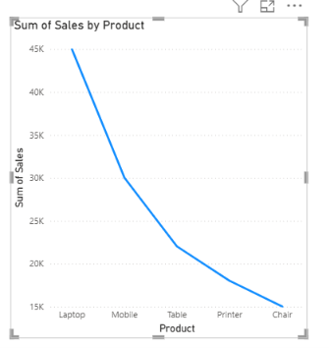
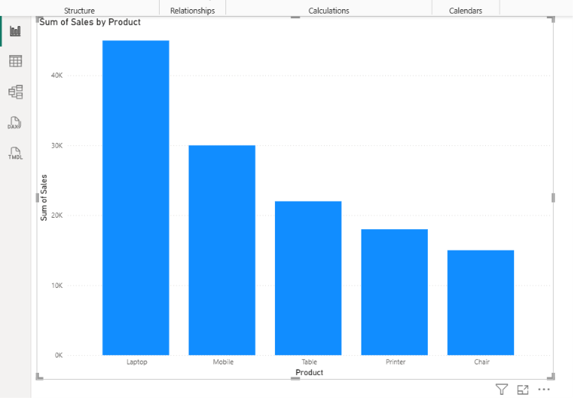
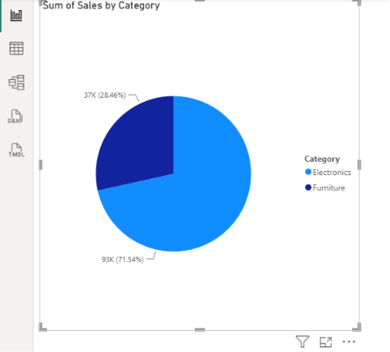

Slide 9
Comparison of Presentation Tools
Feature | Microsoft Excel | Google Colab (Jupyter) | Microsoft Power BI
Primary Purpose | Spreadsheet Analysis | Code-based Data Analysis | Business Intelligence
Programming Required | ❌ No | ✅ Yes (Python) | ❌ No
Charts & Graphs | ✅ Yes | ✅ Yes | ✅ Yes
Interactive Dashboards | ⚠️ Limited | ❌ No | ✅ Excellent
Large Dataset Handling | Moderate | Excellent | Excellent
Ease of Use | Easy | Moderate | Easy to Moderate
Best For | Beginners & Reporting | Data Scientists | Business Analysts & Managers

Slide 10
Application
Conclusion
🏢 Business
Sales performance dashboards
Revenue and profit analysis
🏥 Healthcare
Patient records and disease trend reports
🎓 Education
Student performance and attendance analysis
🏦 Banking
Loan analysis and fraud monitoring
🚚 Retail & E-commerce
Customer behavior and inventory tracking
Converts data into clear visual insights.
Simplifies analysis with charts and dashboards.
Improves communication of results.
Supports faster, data-driven decisions.
Enhances productivity through interactive reporting.

Slide 11
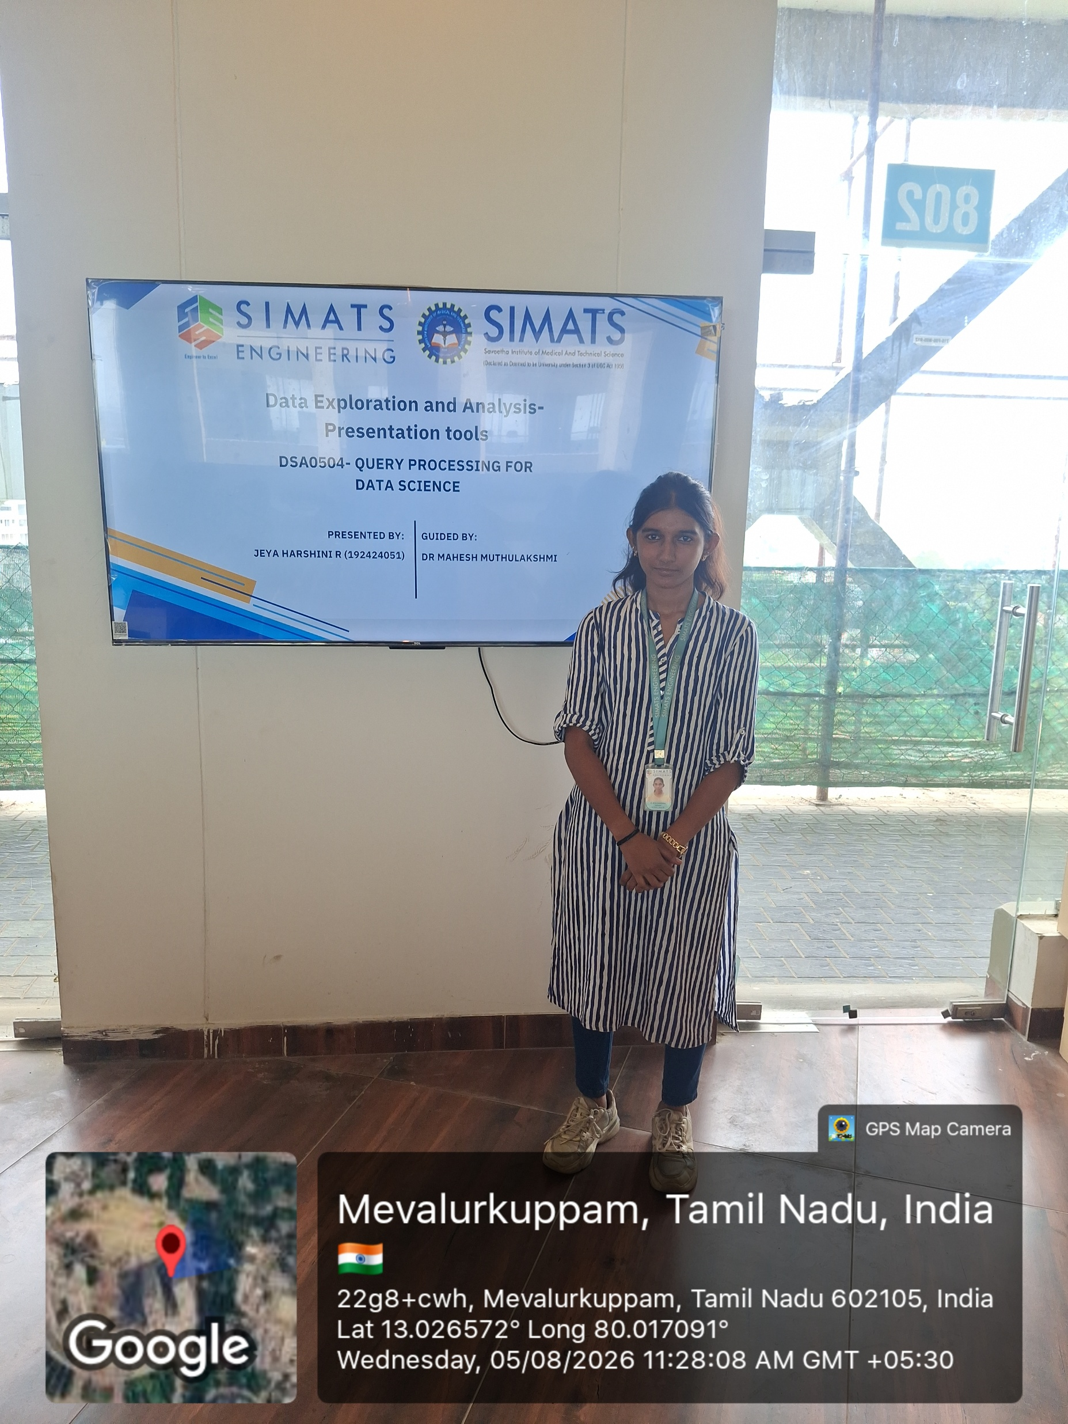
GeoTag

Slide 12
Thank You

